Slide 1
Senior Married Couple
Michael Davenport
Notes:
This lesson is used with NTTC Workbook Exercise Michael Davenport. It covers the following tax topics: Income (rent, pensions, and Social Security), Other Income (prize and jury duty pay), Itemized Deductions, Credits (Residential Energy Credit), and additional practice for interest and IRA Distribution.
Information for conducting this training lesson is contained in the Instructor Guide for Tax-Aide National Tax Training Committee Workbook (Workbook Instructor Guide)
Instructors should add, delete, or modify slides as necessary to meet their district training needs.
Instructors should direct the volunteers to review appropriate section of the Counselor Resource Guide (Pub 4012) whenever possible. If volunteers wish to take notes during class, they should note that Pub 4012 is a good place to record them.
Slides at the end of this presentation provide instructions for entering information for the various tax topic into TaxSlayer. Pub 4012 Tab O is emphasized as the best source for information on entering information into the software.

Slide 2
Senior Married Couple
This lesson will focus on a tax return for a typical retired senior married couple with no dependents
The following tax topics will be discussed:
Miscellaneous: Identity Theft (IP PIN)
Income: Pensions, Social Security, and Rent (land)
Itemized Deductions

Slide 3
Identity Theft
Taxpayers indicate they are victims of Identity theft on the I&I Sheet
We are concerned with tax-related identity theft
Taxpayer has been identified as a victim by the IRS
The tax return rejects because someone has filed a return with the taxpayer’s name and SSN
Notes:
Usually, an identity thief uses a legitimate taxpayer’s identity to fraudulently file a tax return and to claim a refund. Generally, the identity thief will use a stolen SSN to file a forged tax return and attempt to get a fraudulent refund early in the filing season.

Slide 4
Identity Theft - IRS Notices
IRS sends notices to taxpayers identified as victims (or potential victims)
CPO1 – Does NOT provide Identity Protection PIN (IP PIN)
CPO1A – Provides an IP PIN
Taxpayer may or may not bring to the site
IP PINs are issued for the taxpayer, spouse, and dependent victims of identity theft
Notes:
Be alert to possible identity theft if taxpayer receives an IRS notice or letter that states that:
More than one tax return for taxpayer was filed,
Taxpayer had a balance due, refund offset or had collection actions taken against him for a year he did not file a tax return, or
IRS records indicate taxpayer received wages from an employer unknown to him.

Slide 5
Identity Theft – CPO1 Notice
CPO1
“No further action is needed on your part. Please continue to file all federal tax returns”
“We verified your claim of identity theft and placed an identity theft indicator on your account to monitor activity and help prevent future fraud”

Slide 6
Identity Theft – CPO1A Notice
CPO1A
“Keep this letter in a safe place. You’ll need it to prepare your tax return.”
Will receive new IP PIN each year as long as indicator remains on account (usually 3 years)
Your assigned 2019 IP PIN is: [ xxxxxx ]
If you don’t have to file a tax return, you won’t need to use your IP PIN. We still protect your account from fraudulent filing.
Notes:
Instructors should note that taxpayers often do not understand this letter and fail to bring it to the tax site and the fact that they have IP PIN may not be discovered until the return rejects.
A new IP PIN is sent each year. If a taxpayer has been a victim for a few years and needs prior year returns prepared, the current TY IP PIN is used on all returns.

Slide 7
Identity Theft - Hotline
ID Theft Toll-free Hotline 800-908-4490
If taxpayer received IP PIN but lost it
For ID Theft victims who have previously been in contact with the IRS and have not achieved a resolution
The IRS will not provide the IP PIN over the phone
If taxpayer is unable to obtain their IP PIN - IRS guidance is to file a paper return
Notes:
The IRS will not provide the IP PIN over the phone and will not resend the letter. They will tell the taxpayer to file a paper return.

Slide 8
Questions
Answer Davenport question 1
Notes:
The IRS will not provide the IP PIN over the phone and will not resend the letter. They will tell the taxpayer to file a paper return.

Slide 9
Income: Pension Distributions
Pension: Series of determinable payments made to employee (or survivor) after retirement from work
Annuity: Payments under contract from insurance company, trust company or individual
Reported on Forms
1099-R – company plans/annuities
RRB-1099-R – (green) Railroad Retirement benefits
CSA-1099-R – civil service, government plans
Notes:
The term “Pensions” is used generically to refer to employer-sponsored retirement plans
Pension income is generally reported on form 1099-R but may also be reported on RRB-1099-R (green portion) for railroad retiree or Form CSA-1099-R for civil service employees.
Premature IRA distributions prior to age 59½ may result in a 10% tax additional tax. There are exception codes.

Slide 10
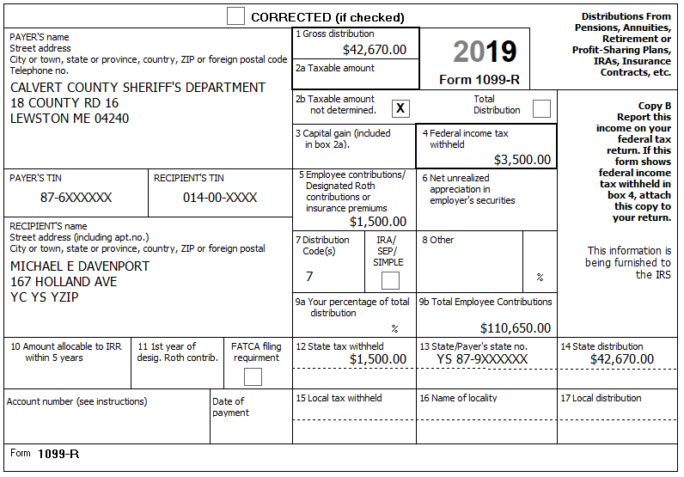
Form 1099-R
Federal after-tax amount that employee contributed to pension
Notes:
Instructors should note that boxes 2b and 9b are often filled out for pensions.

Slide 11
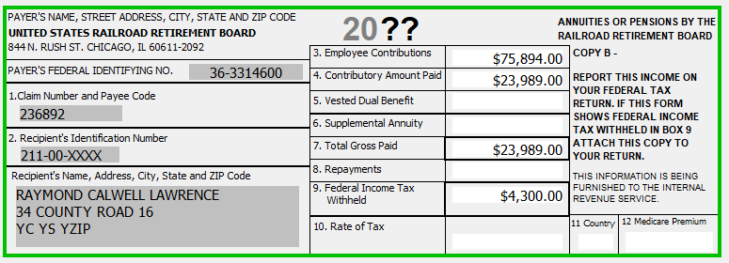
Railroad Retirement RRB-1099-R
Federal after-tax amount that employee contributed to pension
Notes:
Box 7 –Total Gross Paid
Box 9 – Federal Income Tax withheld
Box 3 – Employee Contribution. Use Bogart calculator to determine taxable portion of Tier 2 benefits.
Box 12 – Medicare Premium that needs to be added to Schedule A
See Pub 4012 for directions for entering information. Distribution code is generally 7

Slide 12
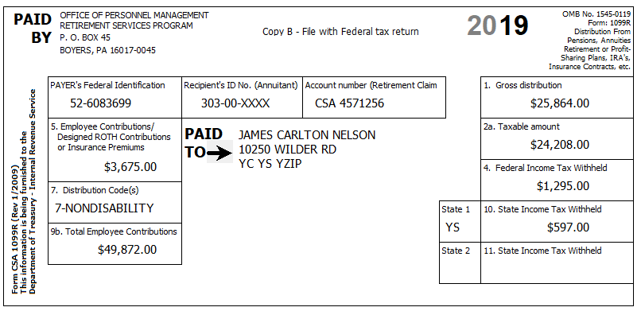
Civil Service CSA 1099-R
Health Insurance premiums
Federal after-tax amount that employee contributed to pension
Notes:
Box 1 – Gross distribution
Box 2a – Taxable amount
Box 7 – Distribution code
Boxes 4 and 10– Federal and State Income Tax withheld
Box 9b – Total employee contribution to be used in Simplified General Rule
Box 5 – Amount entered here is generally health insurance premium but may represent or include the difference between total distribution and the taxable distribution (basis recovery).ASK THE TAXPAYER!
If distribution in box 9b is pre 7/2/1986 the three year rule applies and amount cannot be used.

Slide 13
Income: Pension Distribution – Box 7 Codes
Review Pub 4012 Tab D Form 1099-R Distribution Codes
Most commonly seen:
1 – Early Distribution
3 – Disability
4 – Death
7 – Normal Distribution
Always check the Tax-Aide Scope Manual if unsure if a particular code is in scope

Slide 14
Income: Pension Distribution - Taxable Distributions
Payer reports taxable portion of distribution in Box 2a on Form 1099-R (most common situation)
Retirement plans are funded by either before-tax or after-tax contributions
Before-tax – entire distribution will be fully taxable
After-tax – distribution partially taxable
“Taxable amount not determined” box may be checked on 1099-R
Notes:
If taxpayer says that they have been using the General Rule (rare), send them to a paid preparer.
Simplified General Rule is IN SCOPE while General Rule is OUT OF SCOPE

Slide 15
Income: Pension Distribution - Taxable Distributions
If the taxpayer made after-tax contributions, the amount will be shown in Box 9b on Form 1099-R
The employer may have calculated the taxable amount, and it will be shown in Box 2b
If Box 2b is blank, there are two methods used to figure taxable portion
General Rule – Out of Scope (very rare)
Simplified Method/Simplified General Rule – In scope
Notes:
If taxpayer says that they have been using the General Rule, send them to a paid preparer.

Slide 16
Income: Pension Distribution - Simplified Method
To calculate taxable amount, you will need:
Gross distribution amount (from 1099-R Box 1)
Cost in plan (Box 9b on Form 1099-R and CSA 1099-R or Box 3 on RRB-1099R)
Annuity Start Date* – Relies on good interview especially if spouse receives the annuity and does not remember the start date
* If taxpayer did not start receiving annuity before he/she died, then the date the spouse starts drawing the annuity is used
Notes:
If the starting date of the payments was prior to July 2, 1986, the taxpayer used either the General Rule (which is out of scope) or the “Three Year Rule”. If the latter, the entire amount of the taxpayer’s contribution would have been recovered by now and the entire amount of the payment received this year should be entered in box 2 on the Form 1099-R as taxable. (The “Three Year Rule” was repealed for annuities starting after July 1, 1986.)
If the starting date of the payments was after July 2, 1986, but before January 1, 1987, the annual exclusion continues even after all contributions have been exhausted – for the taxpayer and (if a joint annuity) the spouse, for the rest of their lives.
If the starting date of the payments was after 1986 and before November 19, 1996, the taxpayer had a choice of using the General Rule or the Simplified Method (with some restrictions) and then sticking with that choice. Alternately, the Simplified Method is referred to as the Simplified General Rule. Both are In Scope.

Slide 17
Income: Pension Distribution - Simplified Method
Also need:
Age – Taxpayer’s age on date annuity began
Also spouse’s age if joint/survivor annuity is selected*
Amounts recovered in prior years
Number of months pension paid in current tax year
* If taxpayer did not start receiving annuity before he or she died, then only the spouse’s age when started drawing the annuity is used

Slide 18
Income: Pension Distribution - Simplified Method
Use Bogart’s Pension Calculator
http://tools.cotaxaide.org
Print a copy of the information for the taxpayer
Enter Bogart data into the TaxSlayer Worksheet
Check that the taxable amount in TaxSlayer matches the Bogart calculation
This will provide carryforward information for next year’s return

Slide 19
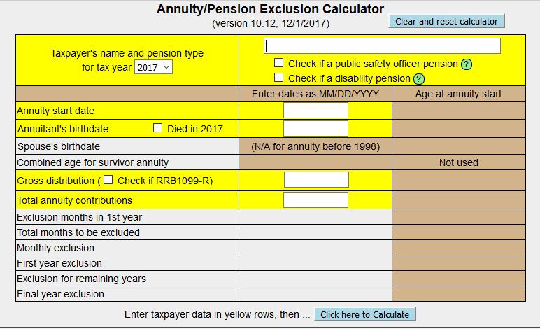
Income: Pension Distribution - Bogart Pension Calculator
http://tools.cotaxaide.org/Annuity%20Calculator.html
Notes:
It would be very helpful to have a link to the Bogart Calculators on all classroom computers.
The Instructor may want to open the calculator and conduct a demonstration for the class.

Slide 20
Public Safety Officer Insurance Premiums on 1099-R
Public Safety Officers (PSO) health insurance premium may be deducted from pension
Up to $3,000 PSO insurance premium can be excluded from taxable amount
Reduce 1099-R Box 2a Taxable Amount by PSO insurance premium amount, not to exceed $3,000
Health or long-term care insurance charges over $3,000 could be possible deductions
Medical section of Schedule A or
Self-employed health adjustment to gross income (if it qualifies)
Notes:
Survivor benefits attributable to a Public Safety Officer who was killed in the line of duty before 1/1/97 are excludible for Federal
Must have retired from PSO position – no intervening jobs
Does not apply to survivor of PSO

Slide 21
Questions
Answer Davenport questions 2 - 5

Slide 22
Income: Social Security
A taxpayer can have Social Security income as:
A retirement benefit (most common)
A disability benefit
A survivor benefit (parent (rare)/spouse/children)
Social Security income must be reported on the return
Benefits are reported on Form 1099-SSA or RRB-1099
Social Security benefits can be taxable depending on AGI (maximum: 85% of benefits)
TaxSlayer calculates

Slide 23
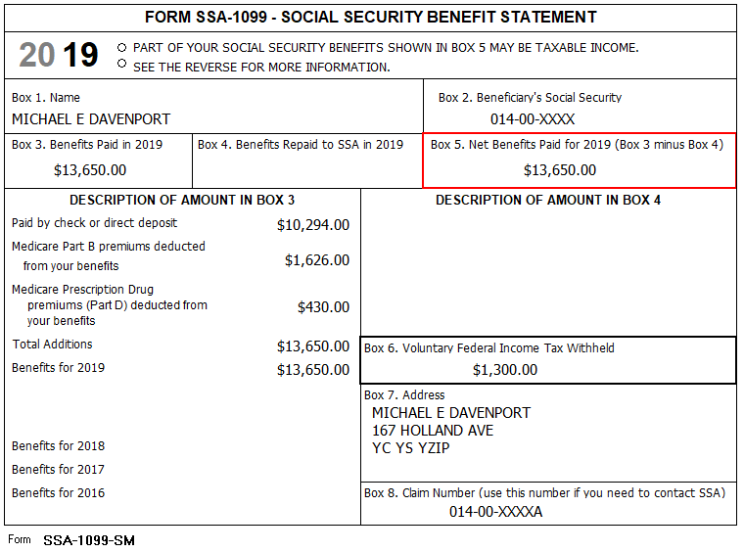
Income: Social Security – Form 1099-SSA
Enter Box 5 as SS amount
Medicare premiums carry to Schedule A
Withholding is rare and can be missed
Notes:
Box 5 is what is entered in TaxSlayer

Slide 24
Income: Social Security – Form RRB-1099
Notes:
Click 2 – Box 11 – Medicare Premium total.
Click 3 – Box 10 – Federal Income Tax Withheld.
Click 2 – Box 10 Federal Income Tax Withheld to be entered on Worksheet 1.
Click 3 – Box 11 Medicare Premium Total to be entered on Worksheet 1.

Slide 25
Income: Rent
Rent income in-scope if
Land only OR gas/oil lease
No buildings or improvements
Reported on a Form 1099-MISC
Received from individual and not reported on 1099-MISC
No Expenses EXCEPT property tax
Report on Schedule A
Rent reported on a K-1 – Out-of-scope

Slide 26
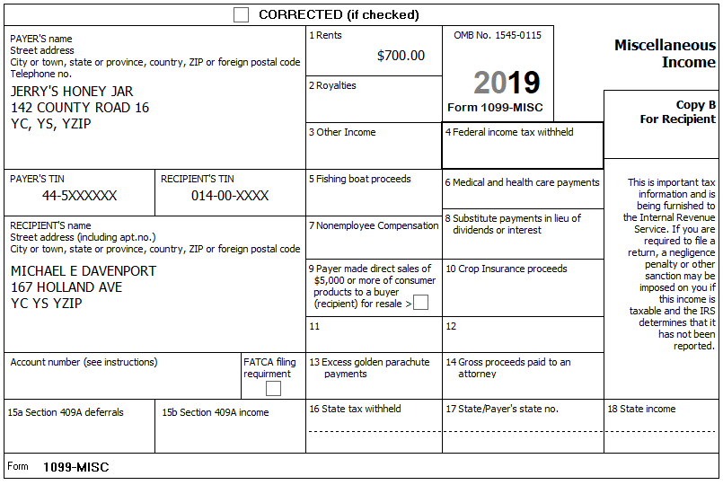
Income: Rent - Form 1099-MISC

Slide 27
Questions
Answer Davenport questions 6 and 7

Slide 28
Deductions
May claim larger of
Standard deduction
Increased amount if at least 65 and/or blind
-OR-
Itemized deductions
If itemized deductions are entered, software will select better option
Due to the increase in standard deductions, most of our taxpayers will not be able to itemize
Notes:
Refer participants to Pub 4012 – Page F-1 for standard deduction amounts

Slide 29
Itemized Deductions
Medical and dental expenses
Taxes
Interest
Gifts to charity
Casualty and theft losses – Out of Scope
Miscellaneous expenses – subject to 2% (not deductible after 2017)
Miscellaneous expenses – not subject to 2% (Gambling Losses)
Refer to Pub 4012 Tab F during this discussion
Notes:
Schedule A Itemized deductions are divided into the listed categories
Casualty and theft losses are out of scope for Tax-Aide
Preparer should organize taxpayer's Deduction documents in this order before beginning Sch A.
ASK taxpayer if there are any other expenses for each category as you organize the paperwork.
Keep the taxpayer involved in what you are doing or you may miss something!
You do not have to total the taxpayer expenses. In the interview, if you find this is the case, ask one of them (if a couple) to sit at a table and create a total for each section.

Slide 30
Itemized Deductions: Medical Expenses
Medical expenses include
Diagnosis, cure, mitigation, treatment, or prevention of disease
Treatments affecting any part or function of body
Equipment, supplies, and diagnostic devices
Premiums for insurance that covers medical care
Long-term care insurance premiums (limited)
Transportation/travel to get medical care
Notes:
Also includes equipment or improvements to your home needed for medical care (e.g. Wheelchair ramp). See Pub 502.

Slide 31
Itemized Deductions: Taxes Paid
Taxes Include
State and local taxes (income tax or general sales tax)
Real estate tax (U.S. or foreign)
Personal property tax based on value (does not apply in NJ)
Foreign income tax (if not claiming a credit)
MUST be imposed on taxpayer
Cannot deduct tax that is paid for someone else (e.g. – a parent)
MUST be paid in current tax year
Total of all taxes you can claim is limited to $10K
Notes:
31
A taxpayer cannot deduct property tax that they for pay someone else (e,g. a parent)

Slide 32
Itemized Deductions: Home Mortgage Interest
Interest on loan secured by main home or second home
Mortgage to buy or build home or second home (both limited)
Home equity loan or line of credit (only if used for improvements on the residence)
Both taxpayer and lender must intend that loan be repaid

Slide 33
Itemized Deductions: Home Mortgage Interest
Mortgages taken out before October 14, 1987 – fully deductible, no limit
Mortgages after October 13, 1987 Limited to $1,000,000 total debt ($500,000 MFS)
Mortgages after December 15, 2017 Limited to $750,000 total debt
Note: Lender late charges are deductible as interest if interest on underlying loan is qualified

Slide 34
Itemized Deductions: Home Mortgage Interest
Points
Paid at loan origination
If to buy or build main home, deductible in full
If to refinance qualified debt, spread over life of loan
If underlying loan is not qualified, points are not deductible
Notes:
Points must be interest equivalents
If to pay for appraisal or other fees, not interest and not deductible

Slide 35
Itemized Deductions: Gifts to Charity
Qualified charity
Churches, governments, schools, etc.
Approved by IRS
U.S. charity
irs.gov/charities for list
Limited to % of AGI
Public charity: <60% of AGI
Private foundations: <20% or 30% of AGI
Notes:
35
Donations to individuals (e.g. homeless) are not deductible
Caution – Some foreign charities may not be qualified by the IRS

Slide 36
Itemized Deductions: Gifts to Charity
Monetary contribution less than $250
Bank record (check, credit card or bank statement) or receipt or written acknowledgement from charity
If payment is >$75, charity must state value of goods/services provided, if any
Monetary contribution $250 or more
Written acknowledgement from charity
Must state value of goods or services provided in exchange for contribution, if any
e.g., fundraising dinner – value of dinner must be deducted from ticket price paid; only net amount deductible
Notes:
36
Taxpayer should have a receipt/evidence for all donations. Can rely on taxpayer’s representations if in line with due diligence, e.g. good faith reliance. Taxpayers should be advised that they would need to produce documentation if requested by the IRS.
“Cash” contributions not allowable without a receipt (i.e. putting $20 each week in the collection plate unless church provides a year end summary – “envelope system”)

Slide 37
Itemized Deductions: Gifts to Charity
Donations of clothing or household items
Deduct fair market value
Usually thrift store value
Good used condition or better
Capital gain or business property donations – out of scope
Any motor vehicle, boat, or plane donations – out of scope
EXCEPTION: Not out of scope - vehicle $500 or less
No Form 1098-C is required (unless submitted by recipient)
Notes:
Capital gain property
If the gain on sale would be a capital gain
A.k.a. appreciated property (such as a painting or sculpture)
Business property
If ever depreciated, donation is out of scope
Motor vehicles includes any motor vehicle manufactured primarily for use on public streets, roads, and highways; a boat; or an airplane.
NOTE: vehicle donation of $500 or less is not out of scope since no Form 1098-C required (unless of course it is submitted by recipient).

Slide 38
Itemized Deductions: Gifts to Charity
Out-of-pocket expenses are also deductible
Mileage @ 14¢/mi
Tolls and parking
Out-of-pocket expenses when serving as volunteer for qualified charity (e.g., hospital volunteer uniform)
Notes:
38
Mileage rate is set in the law, IRS cannot adjust it
Large item example
Buy airplane ticket to attend charity’s event as guest speaker
Charity should give written acknowledgement of speaker’s participation
at the event and that they provided their own airfare
Cannot deduct “value” of time spent as a volunteer

Slide 39
Itemized Deductions: Non-Deductible Contributions
Contributions to following types of organizations:
Business organizations such as Chamber of Commerce
Civic leagues and associations
Political organizations and candidates
Social clubs
Foreign organizations
Homeowners’ associations
Communist organizations
Notes:
Contributions to Chamber of Commerce not deductible, but dues may be a business expense

Slide 40
Itemized Deductions: Miscellaneous
Miscellaneous deductions not subject to 2% floor are still deductible
Gambling wagers and tickets to extent of winnings
Miscellaneous deductions subject to 2% floor are no longer deductible
Unrecovered investment in annuity
Certain work-related expenses for persons with a disability
Repayments of income <$3,000 under claim of right
Certain Ponzi scheme losses
Certain casualty losses – out of scope
Notes:
40
To claim gambling losses
Need to keep a diary of winnings and losses
Generally, use a “per session” determination of whether a gain or loss (not “per bet”)
Example of work-related expenses for a person with a disability
Attendant enabling employment of a person with a disability
Repayments would be of prior year included income that believed was theirs
Such as unemployment benefits or wages
Repayments of <$3,000 are subject to the 2% haircut

Slide 41
Itemized Deductions: Non-Deductible Items
Personal interest
Service charges
Annual fees for credit cards
Loan fees
Credit investigation fees
Interest to purchase or carry tax-exempt securities
Fines and penalties paid to a government for violations of law
Homeowner Association fees
Notes:
If an item relates to a business, it may be deductible as a business expense, e.g. on Sch C

Slide 42
Itemized Deductions – Special Rule
Married filing separately
If one spouse itemizes deductions
The other spouse MUST itemize
Standard deduction not allowed
Does not matter who files first
Does not apply if eligible for Head of Household status

Slide 43
Questions
Answer Davenport questions 8 - 11
Notes:
The IRS will not provide the IP PIN over the phone and will not resend the letter. They will tell the taxpayer to file a paper return.

Slide 44
Supplementary Lesson – Capital Gains/Losses
Ordinary income tax rates range from 10% to 37%
Capital gain tax rates are much lower
Usually 0% or 15% rate
Could be 20% rate for very high incomes
Notes:
Emphasize why capital gains and losses are important
We usually see the 0% or 15% rates
If anyone asks, the net investment income tax (NIIT) was new in 2014. It adds Medicare taxes (3.8%) on investment income for very high income taxpayers (over $250,000 MFJ)

Slide 45
Capital Asset Taxation
Capital gain tax rates apply to “net long-term gains” and qualified dividends
Ordinary income rates apply to “net short-term gains”
Capital gains or losses come from the sale of capital assets
For the most part, everything you own and use for personal purposes, pleasure, or investment is a capital asset.
Business Assets (assets used in a business) are not Capital assets

Slide 46
“Sort-of” Capital Assets
Homes and other non-investment assets
Capital assets for gains
Personal assets for losses
Not deductible
Government is a profits-only partner!
Notes:
A home includes any property used as a residence
Second home
House boat
Mobile home
See Pub 544 Chapter 2, Capital Assets Defined for detail of IRS treatment.

Slide 47
In Scope Capital Assets
Stocks
Mutual fund shares
Exchange traded funds (ETF) shares
Bonds (limited)
Personal Residences
Notes:
Some participants may not know these terms:
Stocks represent an ownership interest in a corporation
Corporations pay dividends to the stock holders
Mutual fund shares represent an ownership interest in a fund, which itself holds stocks or other securities
Mutual funds pass through the dividends or net gains that they realize to their fund share holders
Net losses are not passed out to the fund share holders, they are kept by the fund and used to offset future gains
Bonds represent a debt owed by a corporation, government or other entity
Typically, bonds have a fixed date on which they are to be paid, called the maturity date
Typically, bond issuers pay interest to the bond holder quarterly, semi-annually, or annually that is reported on F 1099-INT

Slide 48
What is NOT a Capital Asset
Inventory is not a capital asset
Assets used in a business are not capital assets
Used as a rental
Used in a business
Copyright, a literary, musical, or artistic composition, letter, memo or similar* are not capital assets
* Held by the creator or letter recipient
Notes:
Sales of these assets are out of scope … see Pub 544 Chapter 2 for further definition of Capital Assets and Noncapital Assets

Slide 49
IRS Reporting Requirements
Schedule D - Capital Gains and Losses
Form 8949 - Sales and other Dispositions of Capital Assets
TaxSlayer fills in appropriate forms

Slide 50
When Is a Transaction Reported
Reported when asset is sold
Reported when asset is otherwise disposed, such as
When bond is redeemed
When it is totally worthless
Exception for certain stock-for-stock transactions
Report only what payer advises for mergers, spin-offs, etc.
Not reported if not a “sale or exchange”
Gift, donation to charity, bequest to heir

Slide 51
Introduction – Sale Of Assets
Key elements of a sale:
When did you buy it
When did you sell it
What is the cost basis
What is the sales price
Notes:
Introduction phase
More details to follow

Slide 52
The Interview
Question 9 in Income section
Notes:
Encourage counselors to ask probing questions
It is not “prying,” it is essential to an accurate return

Slide 53
What is the Basis* of Shares
Cost – amount originally paid
Adjustments to basis* (of shares)
Purchase expenses (commissions)
Sale expenses, if not already used to reduce proceeds
Non-dividend distributions – return of capital
Shown on 1099-DIV statement in Box 3
Reflect a return of principal you invested, so lower your basis
*Basis is term generically used for cost or adjusted basis
Notes:
53
Cost and Cost Basis mean the same thing
Bonds and the adjustment to basis for amortization of premium or discount is beyond the scope of this discussion
If there is any amortization required for a bond, the payer or the taxpayer must
Compute the amortization
Determine the proper basis upon disposition
Covered security: This category was created in Section 403 of the Energy Improvement and Extension Act of 2008 (Public Law 110-343, division B). In US tax law, a covered security is one which, on sale, the broker must report to the IRS the customer's basis and whether the sale is short-term or long-term. This applies to certain types of securities, acquired after a specified effective date – the law phases in between January 1, 2011 and January 1, 2013 (or later).

Slide 54
What is the Basis
What if basis is unknown
Taxpayer could establish basis if knows when it was acquired
Broker or online research can help
Watch out for dividend reinvestment, intervening splits, mergers, etc.
IRS rule: report zero as basis if taxpayer doesn’t have any information
Notes:
54
Cost and Cost Basis mean the same thing
Sometimes for low AGI taxpayers, using $0 as basis will not affect tax amount.

Slide 55
What is the Basis
What if there are multiple buys of an asset
For shares, each buy is called a “lot”
Normally track basis by unit or by “lot”
Example
1st lot: Buy 100 shares of IBM 1/1/2001
2nd lot: Buy 200 more shares of IBM 7/1/2001
Notes:
55
Cost and Cost Basis mean the same thing

Slide 56
What is the Basis
For all shares
Which lot (or part of a lot) was sold
First-in first-out method (default method)
Specific identification method (taxpayer picks which shares were sold at the time of sale)
Important if shares bought at different times had different prices
May affect long or short status
Notes:
56
First-in first-out: – the earliest purchased shares are treated as being sold first, until that lot is depleted; then use the next earliest purchase
For covered securities, described later, brokerages will follow instructions from the account holder on the method they want to use for multiple lots

Slide 57
What is the Basis – Gifts
Property received as gift
Must know basis in the hands of donor
Must know fair market value on day of gift
Which to use?
Depends on which is higher and whether computing gain or loss
Taxpayer needs to provide basis or be referred to paid preparer
Notes:
57
Special rules for gifts received before 1977
See Pub 550 if want more details on property received as a gift

Slide 58
What is the Basis – Inherited
Inherited Property
From decedent who died before or after 2010, but not in 2010
Fair Market Value (FMV)
On date of death -OR-
On alternate valuation date, if elected by estate
Taxpayer needs to provide basis or be referred to paid preparer
Always considered long term
Use “Inherited – Long Term” in TaxSlayer, Date Acquired dropdown selection
Notes:
The executor can choose to value the estate’s assets at the date of death or the alternate valuation date
The Alternate valuation date is the date six months after the date of death
If no estate tax return was filed, basis is fair market value on the date of death
Special rules may apply to community property
Surviving spouse may step up the basis of the whole property to fair market value, not just the decedent’s half

Slide 59
What is the Basis – Inherited
Inherited Property
From decedent who died in 2010
Usually fair market value on date of death (Inherited – Long Term)
Special election by estate
In-scope if basis provided on Form 8939 (received from estate)
Purchase date is same as decedent’s purchase date (shown on Form 8939)
Notes:
If no estate tax return was filed, basis is fair market value on the date of death
INHERIT property is long term

Slide 60
Holding Period – Long and Short Term
When did you buy it? When did you sell it?
Always use “trade date” for securities (settlement date is later)
Begin counting the day after the trade date and include the day of sale
Difference between buy date and sell date is the “holding period”
Long term = held more than one year
Short term = held for one year or less
Notes:
Trade date is the date the buy or sell order is executed
Stocks trade throughout the day the particular stock exchange is open, including after-hour markets
Mutual funds trade at the closing price of the day
Settlement date
Stock – is usually 3 business days after the trade date
Mutual funds – can be the next day or several days later

Slide 61
Holding Period – Long and Short Term
Good news: TaxSlayer does date arithmetic!
Just be sure to carefully enter dates

Slide 62
What is the Sales Price?
Gross proceeds (sales price)
Not reduced for expenses of sale
Taxpayer allowed to adjust profit/loss to reflect sales expenses
Net proceeds
Already reduced for expenses of sale, so use as is
1099-B specifies method used
Notes:
Emphasize
With better reporting by brokers and more taxpayers using brokers, less adjustments are needed to basis
If Taxpayer is trading stock options or futures, they should be referred to a paid prepare

Slide 63
Reporting Sales of Securities
The “payer” prepares the report
Brokerage
Mutual Fund
Corporation’s transfer agent (for shares held directly, not in brokerage)
Clearing house
Uses Form 1099-B or substitute

Slide 64
1099-B Requirements – All Transactions
Payer must report:
Proceeds (gross or net)
Date of transaction
Description and quantity of securities sold
May need to report more information if securities sold are considered “covered securities”
Securities acquired after certain dates in 2011-2013, depending on the type of security

Slide 65
1099-B Requirements – Covered Transactions
If securities sold were “covered securities,” payer must also report:
Cost or other basis
Whether gain or loss is short-term or long-term
A code and adjustment amount, e.g. W for wash sale and amount of loss to disallow (detail on later slide)
Not required for non-covered securities
Some payers still report cost to taxpayer, even though they are not required to report to IRS. Ask taxpayer to confirm cost provided
Notes:
Wash sales discussed later

Slide 66
Consolidating Broker Transactions (per Pub 4012 Tab D)
If numerous capital gains transactions shown on brokerage statement, divide the transactions into 4 categories (brokerage statement usually reports each category separately)
Short term Basis reported to the IRS “Box A” | Long term Basis reported to the IRS “Box D”
Short term Basis not reported to the IRS “Box B” | Long term Basis not reported to the IRS “Box E”
Notes:
See Publication 4012, D-38

Slide 67
Consolidating Broker Transactions per Pub 4012 Tab D
On TaxSlayer Capital Gains/Loss Worksheet, input the summarized sales price and adjusted cost basis for each category separately
Use “Various – Short Term or “Various – Long Term” as the date acquired
Use “adjustment explanation” to indicate that these are summarized transactions
Select: “Reporting Multiple Transactions on a Single Row” as adjustment reason. Adjustment amount is 0
Notes:
See Publication 4012, D-26

Slide 68
Capital Gains Calculations
TaxSlayer does the following automatically:
Determines whether long/short term based on dates entered
Calculates taxable gain/loss
Calculates tax liability
Calculates capital loss carryover to next year
Notes:
68

Slide 69
Net Capital Gain or Loss
After all capital gains transactions are input, TaxSlayer calculates total gains or losses for short- and long-term transactions
If both short- and long-term totals are gains:
Short-term gains taxed at ordinary income tax rates
Long-term gains taxed at capital gains rates
If one total is a gain and other is a loss, TaxSlayer nets the two. The higher amount determines which tax rates apply
Notes:
69

Slide 70
Net Capital Gain or Loss
If net is a capital loss:
Up to $3,000 can be used to reduce other taxable income in the current tax year ($1,500 if MFS)
The loss amount in excess of $3,000 (or $1,500 if MFS) is carried forward to the next tax year
TaxSlayer produces “Capital Loss Carryover Worksheet” to use the following year
Notes:
70

Slide 71
Capital Loss Carryover from Prior Year
Check prior year Schedule D and Carryover Capital Loss Worksheet to determine carryover loss from prior year return
TaxSlayer will provide carryforward data if available
Carryover losses keep their short-term or long-term classification
Carryover losses are combined with the gains and losses that actually occur in the current tax year
Up to $3,000 ($1,500 if MFS) loss offsets other income on current year return. Rest of loss is carried forward to next year
No limit to how many times a loss can be carried forward
Notes:
71

Slide 72
TaxSlayer Data Flow
Enter transaction details on TaxSlayer Capital Gains screen. Then TSO flows info to appropriate tax form
Input
Flows to Forms 8949
Flows to Schedule D
Flows to Form 1040 Line 6
Notes:
TaxSlayer navigation: Try the form search box or Federal Section > Income >Enter Myself

Slide 73
Wash Sales
Definition of a wash sale:
A stock is sold by taxpayer at a loss and substantially equivalent stock is purchased within 30 days (either before or after). The loss is not deductible
1099-B, brokerage statement does all the accounting. Will show:
Original sales price in Box 2 & cost in Box 3
Wash Sales Disallowed in Box 5
Notes:
73

Slide 74
Wash Sales
Enter as an adjustment to a capital gain/loss
Choose “Nondeductible Loss from a Wash Sale” as the adjustment explanation
Enter as a positive number to increase profit/reduce loss
Add disallowed loss to cost basis of new stock bought
Notes:
74

Slide 75
Senior Married Couple – NJ Considerations
This section will focus on NJ aspects of a tax return for a typical retired senior married couple with no dependents
The following tax topics will be discussed:
Basic Information: Disability
Income: Military Pension, Disability Pensions, Pension with After-Tax Contributions, Government Employee Pensions, Pension Exclusions, Recoveries (State Income Tax Refund, Homestead Benefit, PTR)
Deductions: Medical, Taxes Paid
NJ Property Tax deduction/credit
NJ Estimated Payments

Slide 76
Basic Information: Disability
New Jersey has additional exemption if blind or disabled (only one additional exemption if both)
Info about blindness flows through from Federal Basic Information, but you must separately enter disability status which is just for NJ
Capture disability on NJ Checklist, Basic Information section

Slide 77
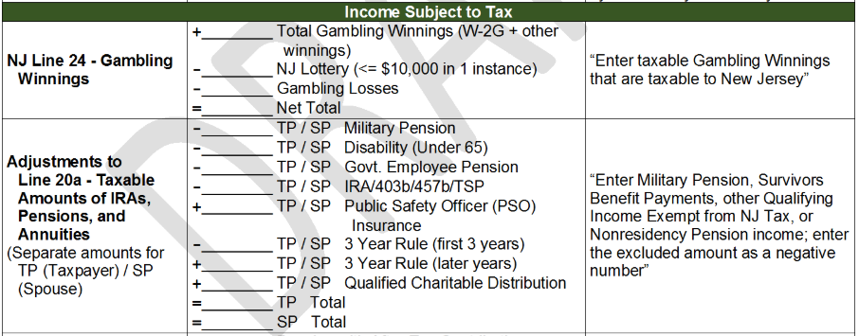
Income: Military Pensions
1099-R from Defense Finance & Accounting SVC
Federal - fully taxed NJ – not taxed. Adjustment to NJ 1040 Line 20a as negative amount. Enter on NJ Checklist

Slide 78
Income: Public Service Officer Premiums
Reported in 1999-R Box 5
Accident, health or long-term care insurance premiums deducted directly from pension. Former Public Safety Officers are allowed up to a $3,000 reduction in Federal taxable income
Cannot also be claimed as medical expense on Federal
Since taxable in NJ, claimed premium amount must be added as a positive adjustment to Line 20a for Pension. Enter on NJ Checklist
Can be claimed as a medical deduction for NJ. Also add on NJ Checklist
Notes:
If premium is more than $3,000, the balance can be claimed as a medical insurance deduction on Sch A.

Slide 79
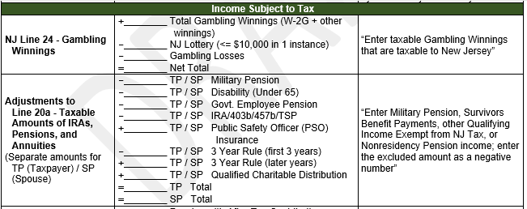
Income: Public Service Officer Premiums (cont’d)
Notes:
If premium is more than $3,000, the balance can be claimed as a medical insurance deduction.

Slide 80
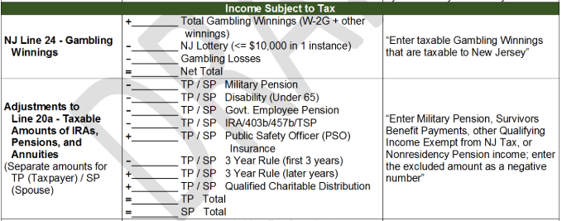
Income: Disability Pensions (1099-R Box 7 Code 3)
NJ – Not taxed if under 65 AND “permanent and total disability”; taxed otherwise
If not taxable for NJ, record box 2a amount as adjustment to Line 20a for Pension, as shown. Note that amount is negative

Slide 81
Income: Pension with After-Tax Contributions
In NJ, non-taxable pension amount must be reported
If 1099-R Box 1 (Gross distribution) is different from Box 2a (Taxable amount)
1099-R Box 1 - Box 2a = non-taxable amount reported on NJ 1040 Line 20b
Capture on NJ Checklist

Slide 82
Income: Government Employee Pension
NJ tax treatment
All government employee pension contributions are taxed by NJ when contributed (after-tax) and are included in W-2 NJ State Wages
Employee pension contributions are pre-tax for Federal when contributed and are not included in W-2 Federal Wages
Therefore, all employee contributions are tax-exempt upon distribution for NJ. Only employer contributions and earnings are taxable for NJ when distributed
Since contributions were not taxed for Federal when made, distributions are all taxable for Federal

Slide 83
Income: Government Employee Pension (cont’d)
NJ tax treatment
To determine the NJ taxable and non-taxable amounts, must use total employee contributions amount, not the amount shown in 1099-R Box 9b (Federal after-tax amount)
Insert total employee contributions in TaxSlayer Simplified General Rule Worksheet or Bogart Annuity Calculator
Total NJ employee contribution amounts can be obtained from NJ Department of Pensions and Benefits
On NJ Checklist Adjustments to Line 20a for Taxable Pension, enter amount necessary to adjust the taxable amount that flows through from the Federal to equal the calculated NJ taxable amount of the distribution
Enter as a negative amount to subtract it from NJ taxable income

Slide 84
Income: Government Employee Pension
(cont’d)
Enter non-taxable amount on NJ Checklist as an adjustment to Line 20b Non-Taxable Pensions

Slide 85
NJ Pension Exclusion - Annual Amounts
NJ allows you to exclude some pension income from taxation
Must be 62 or older or disabled and have $100K or less total income
Exclusion amount based on filing status:
$80K – MFJ
$60K – Single, HOH, QW
$40K – MFS, Married CU Partner
Maximum exclusion cannot exceed total Pension, Annuity & IRA Withdrawal amount on NJ 1040 Line 20a

Slide 86
Income: Recoveries
A recovery is an amount you deducted or took a credit for in an earlier year for which you received a refund
This is a federal concept only; New Jersey does not tax recoveries
A recovery, such as state income tax refunds, Homestead Benefits, and PTR benefits, must be declared as income in the current year IF the taxpayer received a benefit in a prior year (i.e., itemized)

Slide 87
Recoveries: NJ State Income Tax Refunds
NJ income tax refund received this year is not taxable if taxpayer did not benefit from claiming state income taxes on last year’s Schedule A Line 5a
Did not itemize last year OR
Claimed sales tax on Sch A Line 5a, rather than state income taxes
If taxpayer did itemize and claim state income taxes last year, this year’s NJ State Income Tax Refund is taxable to the extent that:
Prior year’s Itemized deductions exceeded standard deductions and
Prior year’s State/local income taxes exceeded sales tax deduction (Schedule A line 5a)
Taxable amount can be determined by using TaxPrep4Free’s NJ Tax Refund Calculator
Prior year’s return is needed for worksheet data
If prior year’s return is not available, entire refund this year is taxable

Slide 88
Recoveries: PTR and Homestead Benefits (HB)
PTR Benefit received this year is taxable if taxpayer itemized last year and claimed property taxes on Schedule A
Taxable amount can be determined by using TaxPrep4Free's NJ e Tax Refund Calculator
Report result on Federal return as “Other Income”
Homestead Benefit is taxable if itemized 3 tax years ago and claimed property taxes on Schedule A (HB is for taxes paid 3 years ago)
Cannot be reduced, it is fully taxable
Reported on Federal as “Other Income”
Notes:
Homestead Benefit cannot be used by the State Refund Worksheet as the worksheet can only be uses the prior tax year’s data.

Slide 89
Recoveries: NJ Adjustments
Recoveries are not taxed in NJ, so they must be backed out as Adjustments to Other Income on NJ 1040 Line 26
Capture on NJ Checklist
Use taxable amount of PTR recovery
Note that both these adjustments are negative amounts
Notes:
Note that the Recovery entries are all negative, so their sum will be a negative amount

Slide 90
Federal Deductions: NJ Considerations
Medical Deductions
NJ medical deduction threshold is 2%. If there is a NJ tax liability, it will benefit the taxpayer if these deductions are entered even if they will not affect the federal return because taxpayer claims standard deduction
Adjustments to post-tax NJ medical expenses can be made for cafeteria 125 plans (W2), FSA/HSA distributions, PSO Health Insurance premiums in 1099-R box 5, and non-dependent costs

Slide 91
NJ Property Tax Deduction or Credit
For: Homeowners, Tenants & Mobile Home Owners
NJ taxable income deduction or tax credit, whichever is most beneficial (TaxSlayer calculates)
Based on real estate tax or rent/mobile home site fees paid
Property Tax Deduction shown on NJ 1040 Line 39; Credit ($50) shown on NJ 1040 Line 54
Eligibility
Age 65 & older OR blind OR disabled OR
Any Age with Gross Income > $20K MFJ (or > $10K Single or MFS)

Slide 92
NJ Property Tax Credit
Homeowners
Get credit as part of Homestead Benefit
Tenants and Mobile homeowners
Get credit with NJ tax return
Homeowners not eligible for Homestead Benefit
Manually complete NJ 1040-H to claim credit

Slide 93
NJ Property Tax Credit: Data Needed to Report
County / Municipality
Property Block/Lot
Use Gross Property Taxes Paid for principal residence
If PTR participant, use base year gross amount; if non-PTR recipient, use current year gross amount
Internet lookup tools are available from TaxPrep4Free’s Preparer page if documentation is not available

Slide 94
NJ Property Tax Credit: Data Needed to Report
(Cont’d)
Data needed can be recorded on NJ Checklist
Basic Information
Credits

Slide 95
NJ Estimated Payments
If taxpayer wishes to make NJ Estimated Payments for next year, capture the amount they wish to pay on NJ Checklist in Miscellaneous Forms section
TaxSlayer can generate the appropriate vouchers that taxpayer should
submit with their estimated tax payments

Slide 96
Questions
Answer Davenport questions 12 - 13

